Slide 1
SPARK DataFrames -Spark SQL POC Project to determine total sales of products based on customer location and transaction time

Slide 2
AGENDA
Project Overview
Technology Used
Architecture Diagram
Hadoop Cluster Configuration
Job Statistics

Slide 3
Project Overview
This project involves
Clean up HDFS directory
Load below input files from HDFS using spark Data Frames
Customer_File
Sales_File
Filter input files to remove headers and unused columns
Transform data to get state, transaction time and sales amount
Convert Epoch timestamp to Year, Month, Day and Hours
Aggregate data to determine sales amount based on customer location and transaction time
Consolidate output files in HDFS

Slide 4
Technology Used
S.No | Tools | Description
1 | SPARK | An open-source distributed general-purpose cluster-computing framework
2 | SCALA | Functional and Object Oriented Programming language
3 | YARN | Resource management and job scheduling technology in Hadoop distributed processing framework.
4 | HDFS | Hadoop Distributed File System
5 | Scripts | Unix Shell Scripts

Slide 5
Architecture Diagram
SPARK Application
Epoch Time Convert
Driver Program
(SPARK Session - spark)
Transformation
Data Frames
Output Files
Wrapper Script
Write Output to HDFS
SPARK Load
HDFS Files

Slide 6
Project Design
Spark_df.sh:
Type: Shell script (wrapper)
Cleans up HDFS output directory
Submits spark job in YARN cluster
Consolidates SPARK job output files in HDFS
Driver.scala:
Type: Object
Main program used to instantiate Spark Session
Creates Transform class instance and passes Spark Session
Transform_RDD.scala:
Type: Class
Loads input files (Customer_File, Sales_File) from HDFS into Spark Dataframes
Filters input files
Remove headers
Splits the input files based on de-limiter “#”
Create temporary views for Customer and Sales Data Frames
create a Spark UDF (User Defined Function) to convert Epoch Timestamp into Year, Month, Day and Hour granularities
Using Spark SQL, aggregate total sales price according to state and transaction time
Write output file in HDFS using spark.write dataframe method with de-limiter ‘#’

Slide 7
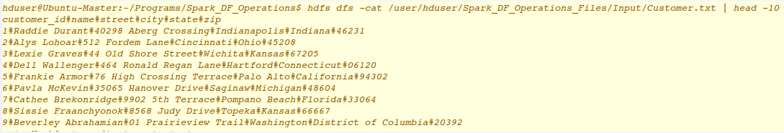
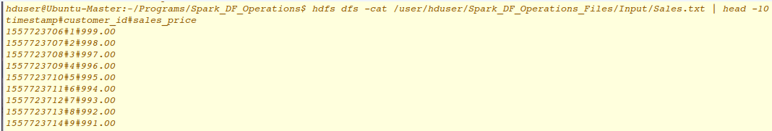
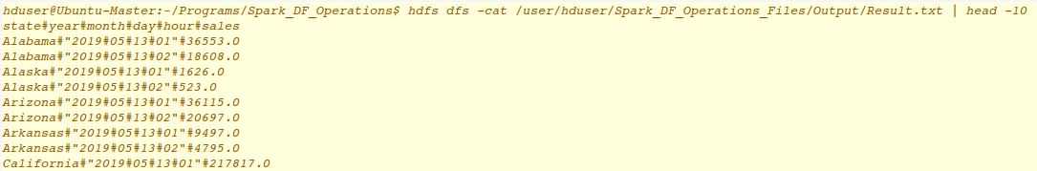
Sample Input and Output Files
Input Files:
Output Files:

Slide 8
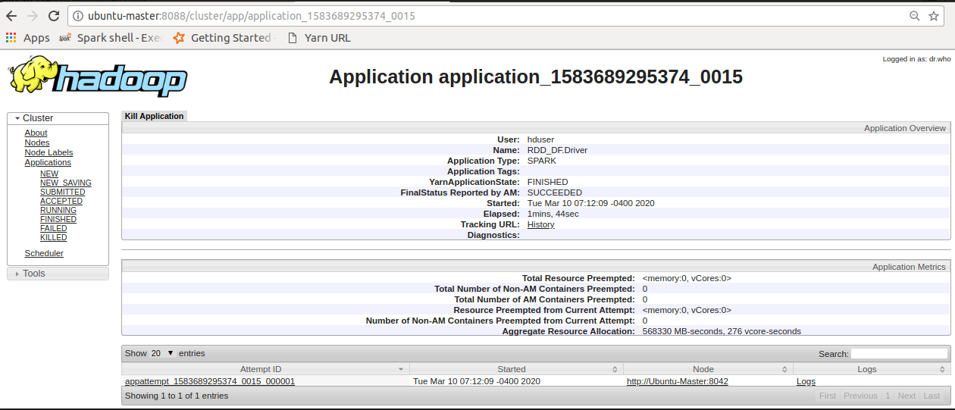
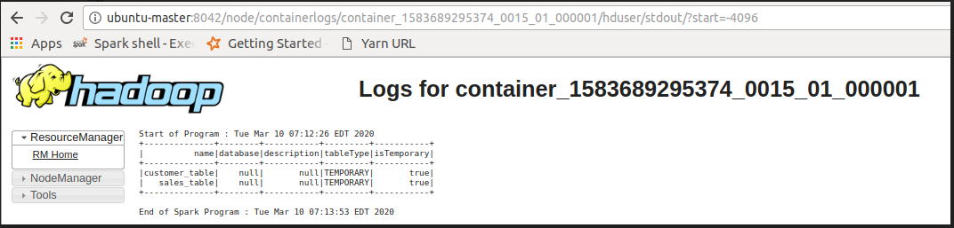
YARN Logs

Slide 9
Cluster Configuration
S.No | Component | Version / Details
1 | Java | 1.8.0_144
2 | Ubuntu | 14.04 LTS
3 | Hadoop | 2.7.1
4 | SPARK | 2.4.3
5 | SCALA | 2.11.12
6 | Nodes in cluster | 1
7 | yarn.scheduler.maximum-allocation-mb | 3072 MB (3 GB)
7 | spark.driver.memory | 1024m
8 | spark.yarn.am.memory | 1024m
9 | spark.executor.memory | 1024m
10 | spark.executor.memoryOverhead | 384m

Slide 10
Job Statistics
S.No | Files | Process | Mode | Data Size (KB) | Job Run Time (Minutes:Seconds)
1 | Customer_File | SPARK | Cluster | 61.58 | 3:00
2 | Sales_File | SPARK | Cluster | 115.87
3 | Customer_File | SPARK | Client | 61.58 | 3:00
4 | Sales_File | SPARK | Client | 115.87
5 | Customer_File | SPARK | Local | 61.58 | 1:00
6 | Sales_File | SPARK | Local | 115.87

